Slide 1
PARTY
featuring the
2013
Ginny Valentine
Badge of Courage Awards
Refreshments provided by
Notes:
FB: Welcome everyone!
I am Fiona Blades, CEO of Mesh Planning and founding member of the Research Liberation Front. A few remarks and then we will get the meat of the evening underway. We have some guests who are actually going on to the Ogilvy Dinner, so we will try to give them a chance to share in the festivities before they have to dash. I am joined this evening by my colleague Susan Griffin, CMO of BrainJuicer, who will help us facilitate the evening.
SG: Thanks Fiona! This is the second annual GRIT Party, brought to you by Greenbook, celebrating the best, the most trending and innovative aspects of the market research industry. The latest issue of the GRIT report is just out and it is quite an interesting read. Copies are available online and here tonight.
So a big thanks for
Diane Liebensohn, Publisher Greenbook Directories, Lukas Pospichal, Managing Director Greenbook’s Publisher, and Lenny Murphy, the voice of Greenbook blog, who sadly couldn’t be here tonight. If Market Research were a town, Lenny would be the mayor!

Slide 2
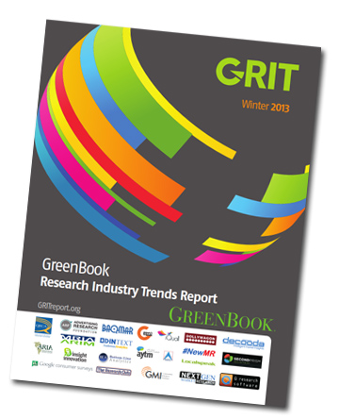
We are here to celebrate GRIT…
Notes:
SG: We are here to Celebrate True Grit: and GreenBook for bringing it to us, but also

Slide 3
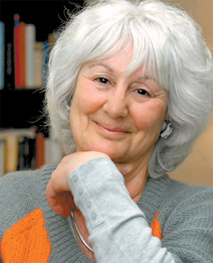
And Bravery in Market Research!
GINNY
VALENTINE
BADGE OF
COURAGE
AWARD
2013
Notes:
SG: Bravery in Market Research and the winners of the second Annual Ginny Valentine Badge of Courage Award for Bravery in Market Research.

Slide 4
Many Thanks to our Party Sponsors
Notes:
SG: So thanks to our Party Sponsors, GreenBook and especially Google Consumer Surveys for their generosity.

Slide 5
And the organizers of the Ginny Valentine Awards
Notes:
SG: And to the organizers of the Ginny Valentine Awards: Greenbook, our crowdsourcing partner, KL Communications who help gather the nominations and the originator of the awards, the Research Liberation Front!

Slide 6
Many Thanks to Our Distinguished Judges
Angry MR Client (Agent Provocateur)
Jon Puleston (GMI)
Diane Hessan (Communispace)
Catherine Moffatt (Diageo)
Alec Maki (Bellomy Research)
Notes:
FB: We had a great group of Judges who we would all like to thank for their time and support of these awards.:
Angry MR Client (Agent Provocateur)
Jon Puleston (GMI)
Diane Hessan (Communispace)
Catherine Moffatt (Diageo)
Alec Maki (Bellomy Research)
The discussions the judges had were inspirational for those of us listening in. They performed their parts admirably, standing up for their own views. Whilst some of the choices for awards were fast and unanimous, others took much debating!
Each award will be introduced by one of our judges tonight, in person, or with words they have sent in advance.

Slide 7
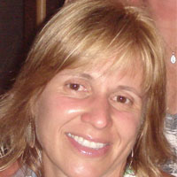
And Acknowledgement of Past Recipients Here Tonight!
Awarded for Breaking Away from the Roster
Ana Alvarez, PepsiCo Brazil
Notes:
FB: And we even have one of last year’s winner, Ana Alvarez all the way from PepsiCo Brazil! Ana? Please wave your hand!

Slide 8
So who was Ginny Valentine? And what made her so brave?
Notes:
FB: Ginny Valentine brought semiotic techniques to the market research industry and in 1988 set up Semiotic Solutions to provide semiotics training and advance technical development. She won numerous awards during her career and was a fellow of the MRS but she faced a hard struggle to get semiotics fully embraced.
Shortly after her death on November 29, 2010, Ginny’s son, Phil got in contact with John Griffiths and I, as founders of the Research Liberation Front. In spite of all her awards, the one that had meant the most was being voted the No 1 Revolutionary of all time, by her peers at the first RLF event in 2007. He asked us if we could find some way to remember Ginny and we came up with the Badge of Courage Award.
Unfortunately, Phil can’t be here in person tonight but he has sent us a few words:
I am so thrilled that this event has made it into a second year, thanks of course to the incredible efforts of Fiona, John Griffiths and many others.
New York, along with Dublin, was my mum's favourite city. I realise that this is a pretty popular choice, but it's worth saying just why she loved it, as it's closely related to tonight's event. Nowhere else works harder, longer and with more joy, energy and passion than this place. This restless buzz and drive was something that my mum thrived on.
But the second reason that Ginny loved New York is that she was always, first and foremost, an actress. The youngest in her year at RADA in London and the oldest recipient of the best actor award in the Norfolk village where she spent her last ten years, Ginny carried her sense of the dramatic through her entire life. This not only made her presentations and papers stylish and witty, it also meant that she worked especially hard to make some very complex ideas as accessible as possible. The way that the whole city parades itself on its streets, in its parks, in its bars and with that irrepressible New York verbal dexterity was something which Ginny adored, admired and was constantly exhilarated by.
Ginny didn't believe in shirking responsibility: to her family, to herself, to her beliefs and to her work. It was this which carried her efforts to convince the UK (and subsequently international) market research fraternity that there really was something to all this weird semiotics stuff after all. It was this sense of responsibility which meant that she refused to work on anything which she considered undermined gender, racial or sexual equality. She also felt a responsibility to turn in work that not only met her client's standards, but also her own - far more exacting - ones. This inevitably meant late nights (mostly just before a debrief), but also long, involved, fascinating and frequently contradictory discussions between her, my dad and me - over the dinner table, on holiday, walking the dogs...
As I type this, my young son Sammy is sitting next to me…. Ginny's grandson also shows me what I have learnt from her: a responsibility to my family, to myself and to my beliefs. And the fact that - in another fine New Yorker Marshall Berman's words - we are living in a historical situation and at times we have to take sides.
My mum never minded taking a side or two. In fact, it was one of the things she lived for. And New York is a place where the whole world takes sides - loudly and proudly.
I am sure you will have a wonderful evening and I wish everyone there my warmest congratulations on behalf of my mum Ginny Valentine.
Needless to say, she is looking down from wherever it is that determined cultural materialists end up, smiling that big smile of hers and whooping with delight.
Love, Phil

Slide 9
So what constitutes bravery?
“Bravery takes many forms:
developing a new approach; struggling with a difficult brief; undertaking cultural research methodologies such as semiotics and ethnography; setting up new venture; pushing through controversial projects; pioneering new approaches in a client organization, even physical danger, to name a few. In all cases, we are looking for nominees with persistence, drive, and guts.”
Notes:
SG: So what’s bravery? This was the language on the solicitation for nominations page. And we got many very inspiring submissions that ran the gamut. This award seeks to acknowledge bravery, in many forms, in an industry not often known for brave acts. But central to the nomination were the three words: persistence, drive and guts.
The winners we are about to announce are provocateurs, hidden heroes, and inspiring risk takers, who exemplify audacity and conviction in our field, and spur us all on to greatness.

Slide 10
And now the winners are….
Notes:
Fiona: So on to the winners,
As we announce them one of the judges or their designees will say a few words about the nominee/winners and why the judges chose them;

Slide 11
Fearlessly Advocating Gender Equality
Kristin Luck, Decipher
Notes:
Fiona: Announcing Kristin will be Alec Maki of Bellomy Research.
Her nomination: For fearlessly advocating for gender equality in MR and championing the professional growth of women everywhere!

Slide 12
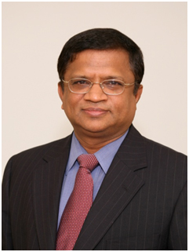
Leading by Principle
Stan Sthanunathan, Coca-Cola
Notes:
Susan: Speaking on behalf of Stan’s award is Diane Hessan, CEO of Communispace
Stan’s Nomination: For bravery suggesting that research suppliers should be paid on the basis of the ROI were clients to use their results as decision support. Not matter how challenging this might be to implement, Stan called out the "elephant in the room" that research needs to stand up to scrutiny that it will enable measurable business advantage or else it is not worth doing.

Slide 13
Raw Bravery for the Greater Good
Batool Batalvi, SB&B Marketing Research
Notes:
Fiona: Speaking on behalf of Batool is Catherine Moffatt of Diageo, one of our distinguished judges. We happen to have Batool’s nominator, Howard Moskowitz in the audience tonight. Howard? Please raise a hand.
Batool’s nomination: Dr. Howard R. Moskowitz, Ph.D, would like to nominate Batool Batalvia, founder of SB & B Marketing Research (Lahore, Pakistan and Toronto, Canada). Batool has been doing social research in Southeast Asia, on behalf of aid organizations. Her company headquarters in Lahore were blown up by terrorists as a result, with people killed. She relocated to Toronto, but continues to maintain a company in Pakistan, and has focused both on social marketing for the good of people in Pakistan, and for commercial purposes Batool (and I) did a presentation for the Bill and Melinda Gates Foundation in Seattle. It focused on the introduction of a new, fortified golden rice into Pakistan. The first section of the presentation showed her business and the aftermath of the terrorist attack. She is, perhaps, the bravest researcher I have ever known
.

Slide 14
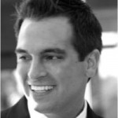
Taking Action
Kyle Nel, Lowe’s Home Improvement
Notes:
Susan: One of our mot interesting Judges has established his/her persona on Twitter as Angry MR Client, who could not be here tonight.
but as a fellow “client sider” . . . “angry” appreciates what it is like to walk in Kyle shoes.
Kyle’s nomination: I would like to nominate Kyle for bravery because in a time of budget constraints Kyle used a very ingenious tactic to be able to experiment with new research innovations. He killed a tracking study that was yielding very little in terms of directional decision support, implemented some very simple and inexpensive DIY research using Google Consumer Surveys to get some quick incremental insights instead, and took the budgetary dif ferential and applied it to doing more experimental work that could move the needle, more effectively than what had been done before.
Angry (spoken by Catherine): Staying comfortable is easy. Making brave decisions is not. But then nothing worth doing is easy. Kyle's decision to replace a tracker with Google surveys, and then invest the difference in high risk, experimental work is a great example of bravery in market research. I know how difficult it is to stand up to marketers who love their KPIs and convince them to go into unknown territory. Kyle did a great job at that. Kyle is also involved in the AMP social good programme for accelerating market potential by sharing data across organisations, a grant worth 1.2 billion in emerging markets. Kyle is driving that with Lowe so he’s bringing a lot to the research industry at the moment. For all these reasons I feel that he fully deserves the Taking Action Ginny Valentine Badge of Courage Award.

Slide 15
Waking the Industry Up
John Kearon, BrainJuicer
Notes:
Fiona: Reading the comments of Jon Puleston, one of our judges who could not be here tonight is Alec Maki, on John Kearon’s entry
John’s Nomination: I would like to nominate John Kearon, Founder of Brainjuicer, for the Ginny Valentine Badge of Courage Award. He has worked tirelessly and relentlessly to drive research innovation and improve the overall status and significance of market research.
Jon’s words (read by Alec)
This award is not being given to John for innovation, this is an award is being given to John for his courage to “stand up, say it and do it”.
This is an award for someone who has for the last decade and stood up and said “this is what the industry should do” and then has put his money where his mouth is and tried to do it. He has stood up and challenged the industry to do things differently and has lead by example.
Having set up a small research business, but also undertaken an innovation role in much larger business I am aware what courage this has taken. Innovation is very easy to talk about and promote when you are not carrying any of the personal risks, but it can be a really scary thing to contemplate when you have to borrow money and put your livelihood on the line to implement it. When the decisions you make are putting not only yours but the livelihoods of your staff and their families on the line too these decisions required even more courage.

Slide 16
Grace under Fire
Manish Makhijani, Unilever
Notes:
Susan: Speaking on behalf of Manish’s award is Catherine Moffatt of Diageo
REASON FOR NOMINATION I am nominating Manish Makhijani for his initiation, leadership and implementation of an accreditation scheme (the Qualitative Researcher Accreditation programme) designed to raise the quality of qualitative research within the Unilever business globally through only working with accredited research leads and moderators in order to help deliver superior consumer insight. The programme was initially launched in early 2010 with roll out to all agencies in the UK and elsewhere from April 2012.
Previous to this there was no industry standard or process in place. It therefore took a brave client to single-handedly initiate regulation in a previously unstandardized industry! Unsurprisingly, the announcement caused a massive stir in the qualitative industry and broader MR community during 2012 with some applauding Unilever for taking a stand against falling supplier standards, whilst others said the real problem was that Unilever’s own researchers didn’t know what quality looked like. The hue and cry reached such a fever pitch that senior members of the Unilever consumer and market insight team decided to discuss and answer quallies’ concerns at the Association of Qualitative Research’s summer lunch. In addition, Manish himself provided a lengthy interview for Research-Live about the topic – to me, this demonstrated a real faith in his convictions despite such a large backlash

Slide 17
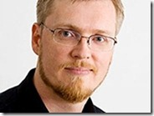
Networking and Rabble Rousing
Tom HC Anderson, Anderson Analytics
Notes:
Fiona: Alec will read out Jon Puleston’s words on behalf of Tom Anderson. Jon couldn’t be here tonight but he sent us the following notes:
Tom’s Nomination:
For pioneering text analytics in marketing research as well as advocating responsible use of other next gen market and data mining research techniques
Jon’s words (read by Alec)
This award for Tom Anderson is for “voicing an opinion”. Tom Anderson can come across as quite an abrasive figure to some people, but this because here is a person who has the mettle to actually say what he thinks.
Many of us when communicating in a public forum have a tendency to skirt around issues that we feel are politically sensitive, or could run counter to the prevailing wind of opinion, we hold back our true feelings and tend to voice them more quietly in less public forums and behind closed doors, but Tom has never been a person to hide behind this hypocrisy of believing something but saying something else, having a viewpoint on something and holding it back from voicing it for fear of what people will think of you.
Whilst he often is prepared to put forward what some may view as controversial view points on some issue, I don’t think I have ever read an opinion voice by him that I felt did not truly reflect a sincere point of view.
The Next gen community that he fostered has been a force for change within the industry and it wouldn’t have worked unless it was lead from the front by someone who stuck their neck out and voiced their opinions. He drives discussion by often making very bold statements, placing his position on things on the line and as a result opening himself up for fire. He has tended to isolate himself on occasion by doing that and that is bravery. Without people like you
Tom, the industry would be a poorer, weaker willed place, with more cow-towing, buttering up and brushing under the carpet and herd mentality.
Tom you have helped the industry face up to issue and helped provoke change and for this you are receiving this award.

Slide 18
Giving a Voice to the People
Catalina Meija and Yanhaas
Notes:
Susan: Alec will provide the judges perspective on Catalina’s award. As the East Coast representative for ESOMAR, the organisation that nominated Catalina, we are enormously privileged to have Catalina with us tonight all the way from Columbia.
ESOMAR would like to nominate Catalina Mejia and YanHaas Research for the 2013 Ginny Valentine Badge of Courage. Catalina and the YanHaas team showed extraordinary bravery and perseverance while interviewing Colombians about their impressions of the state of the nation and the presence of the military. Research will always be challenging in a country with uneven infrastructure, but the sensitive nature of this topic in FARC territory made the YanHaas team the target of threats, surveillance, and detentions by guerilla forces. We are inspired by Catalina’s dedication to her work, which demonstrates the power of information and the courage it often takes to unlock it. In her words, this nominated project gave YanHaas and its clients the “satisfaction of learning about the reality of our country and our people, which is what all researchers ultimately search for.” Our full submission video is embedded below and can be found on YouTube:

Slide 19
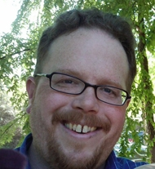
For Openness and Soldiering On
Lenny Murphy, Greenbook
Notes:
Fiona (?) to announce the special prize
Diane to give reasons.

Slide 20
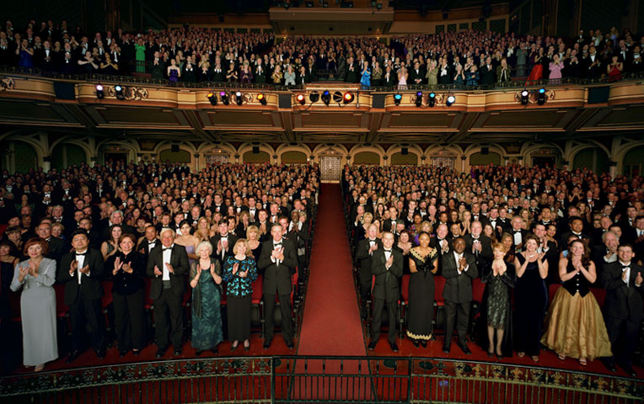
Notes:
Fiona: So congratulations to all the winners. Let’s give them a final round of applause.
And keep an eye peeled for who you are going to nominate for next year’s awards.

Slide 21
Join Greenbook at the upcoming Insight Innovation Exchanges
Sao Paulo, March 25, 26
Philadelphia
June 17, 18
Notes:
Please enjoy the rest of the evening, and please check out the Insight Innovation Exchange conferences in Sao Paulo and Philadelphia!

Slide 22
Congratulations to the Winners!
PARTY
featuring the
2013
Ginny Valentine
Badge of Courage Awards
Refreshments provided by
Notes:
[This slide will be up for the rest of the evening.]

